Slide 1
IP Addressing

Slide 2
What is an IP Address?
An IP address is a unique global address for a network interface
An Internet Protocol address (IP address) is a numerical label assigned to each device connected to a computer network that uses the Internet Protocol for communication

Slide 3
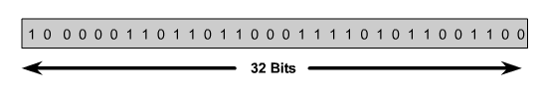

IPv4 Address
An IPv4 address is a 32-bit sequence of 1s and 0s.
To make the IP address easier to use, the address is usually written as four decimal numbers separated by periods.
This way of writing the address is called the dotted decimal format.

Slide 4
IP structure
IP addresses consist of four sections
Each section is 8 bits long
Each section can range from 0 to 255
Written, for example, 128.35.0.72
Notes:
An IP address consists of four sections separated by dots.
Commonly written in decimal Each section contains a number ranging from 0 to 255. Example = 128.35.0.72

Slide 5
Address Space
…………..
…………..
addr1
addr15
addr2
…………..
…………..
…………..
addr41
addr226
addr31
…………..
…………..

Slide 6
RULE:
…………..
…………..
If a protocol uses N bits to
define an address,
the address space is 2^{N}
because each bit can have two
different values (0 and 1)
and N bits can have 2^{N} values.
addr1
addr15
addr2
…………..
…………..
…………..
addr41
addr226
addr31
…………..
…………..

Slide 7
The address space of IPv4 is 2³² or 4,294,967,296.

Slide 8
Dotted Decimal Notation
IP addresses are written in a so-called dotted decimal notation
Each byte is identified by a decimal number in the range [0..255]:
Example:
10000000
10001111
10001001
10010000
1st Byte
= 128
2nd Byte
= 143
3rd Byte
= 137
4th Byte
= 144
128.143.137.144

Slide 9
Hexadecimal Notation
0111 0101 1001 0101 0001 1101 1110 1010
75 95 1D EA
0x75951DEA

Slide 10
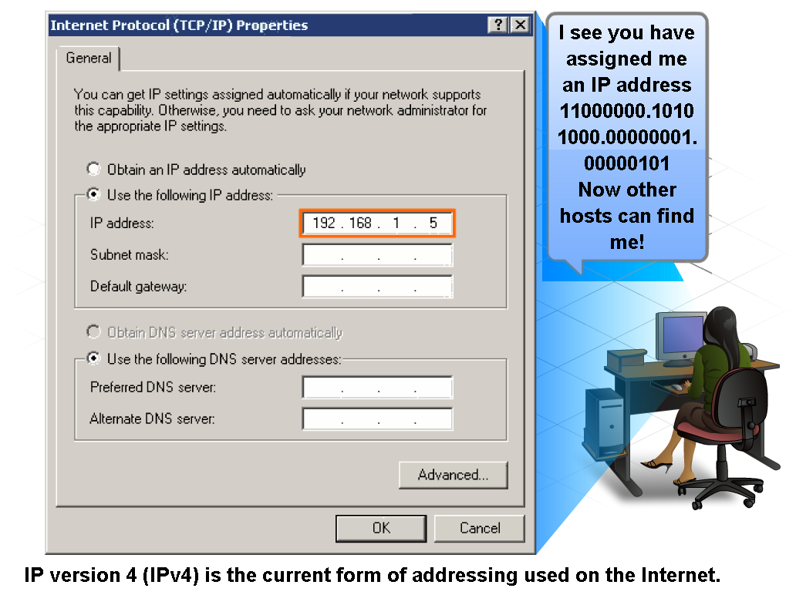
IP Addressing Structure
Describe the dotted decimal structure of a binary IP address and label its parts

Slide 11
Example 1
Change the following IP address from binary notation to dotted-decimal notation.
10000001 00001011 00001011 11101111
Solution
129.11.11.239

Slide 12
Example 2
Change the following IP address from dotted-decimal notation to binary notation.
111.56.45.78
Solution
01101111 00111000 00101101 01001110

Slide 13
Example 3
Find the error, if any, in the following IP address:
111.56.045.78
Solution
There are no leading zeroes in
dotted-decimal notation (045).

Slide 14
Example 3 (continued)
Find the error, if any, in the following IP address:
75.45.301.14
Solution
In dotted-decimal notation,
each number is less than or
equal to 255; 301 is outside this range.

